Slide 1


Virtual Reality: From the Movies to your
Living Room with Oculus Rift & Kinect
Dr Bryan Duggan
DIT School of Computing
bryan.duggan@dit.ie
@ditcomputing
http://facebook.com/ditschoolofcomputing

Slide 2
Overview
Bacground
Some examples from the history of virtual reality
Virtual reality real & imagined
Technology
Kinect
Oculus Rift

Slide 3
What is virtual reality?
Humans like telling stories
Creating imaginary worlds
Books, pictures, movies, TV, computer games
Virtual reality
To create a simulated experience
The experience is

Slide 4
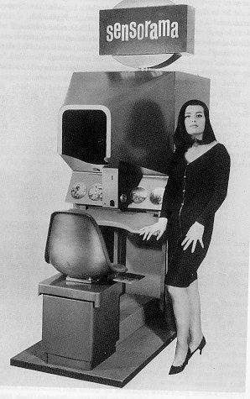
Helig’s Sensorama
Immersive cinema experiences
Built in 1962
Still works!

